Slide 1
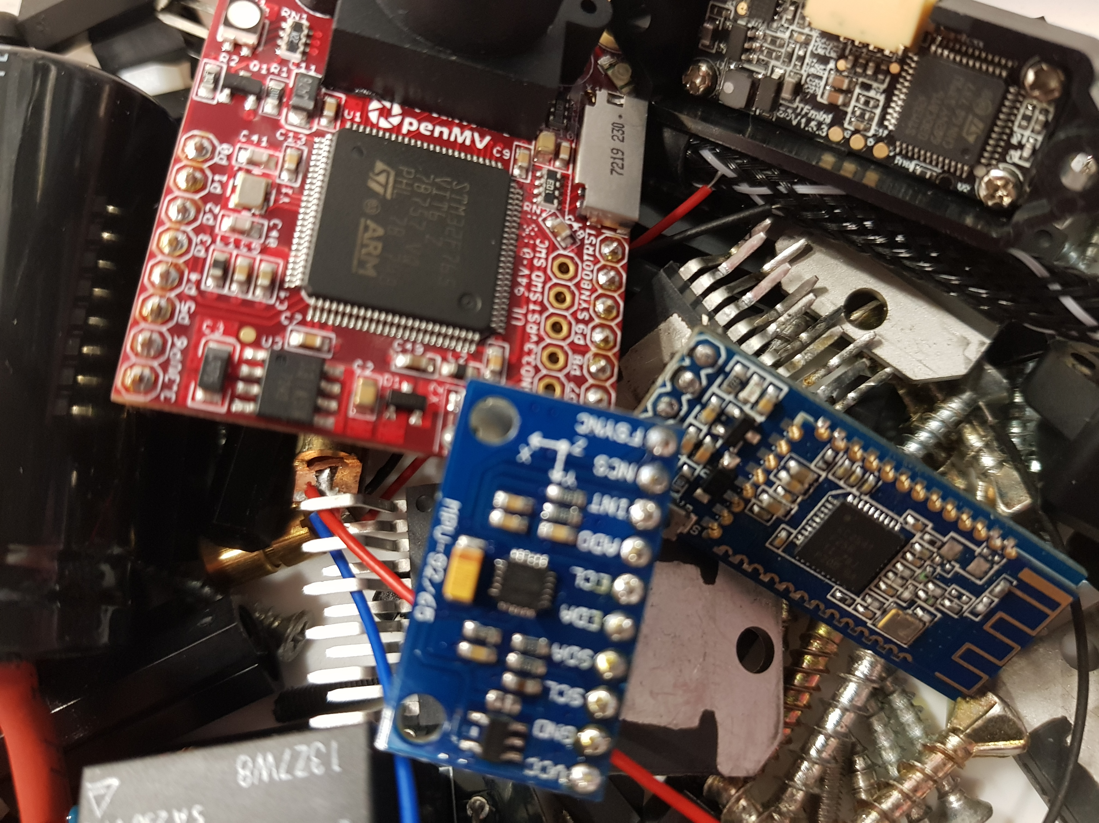

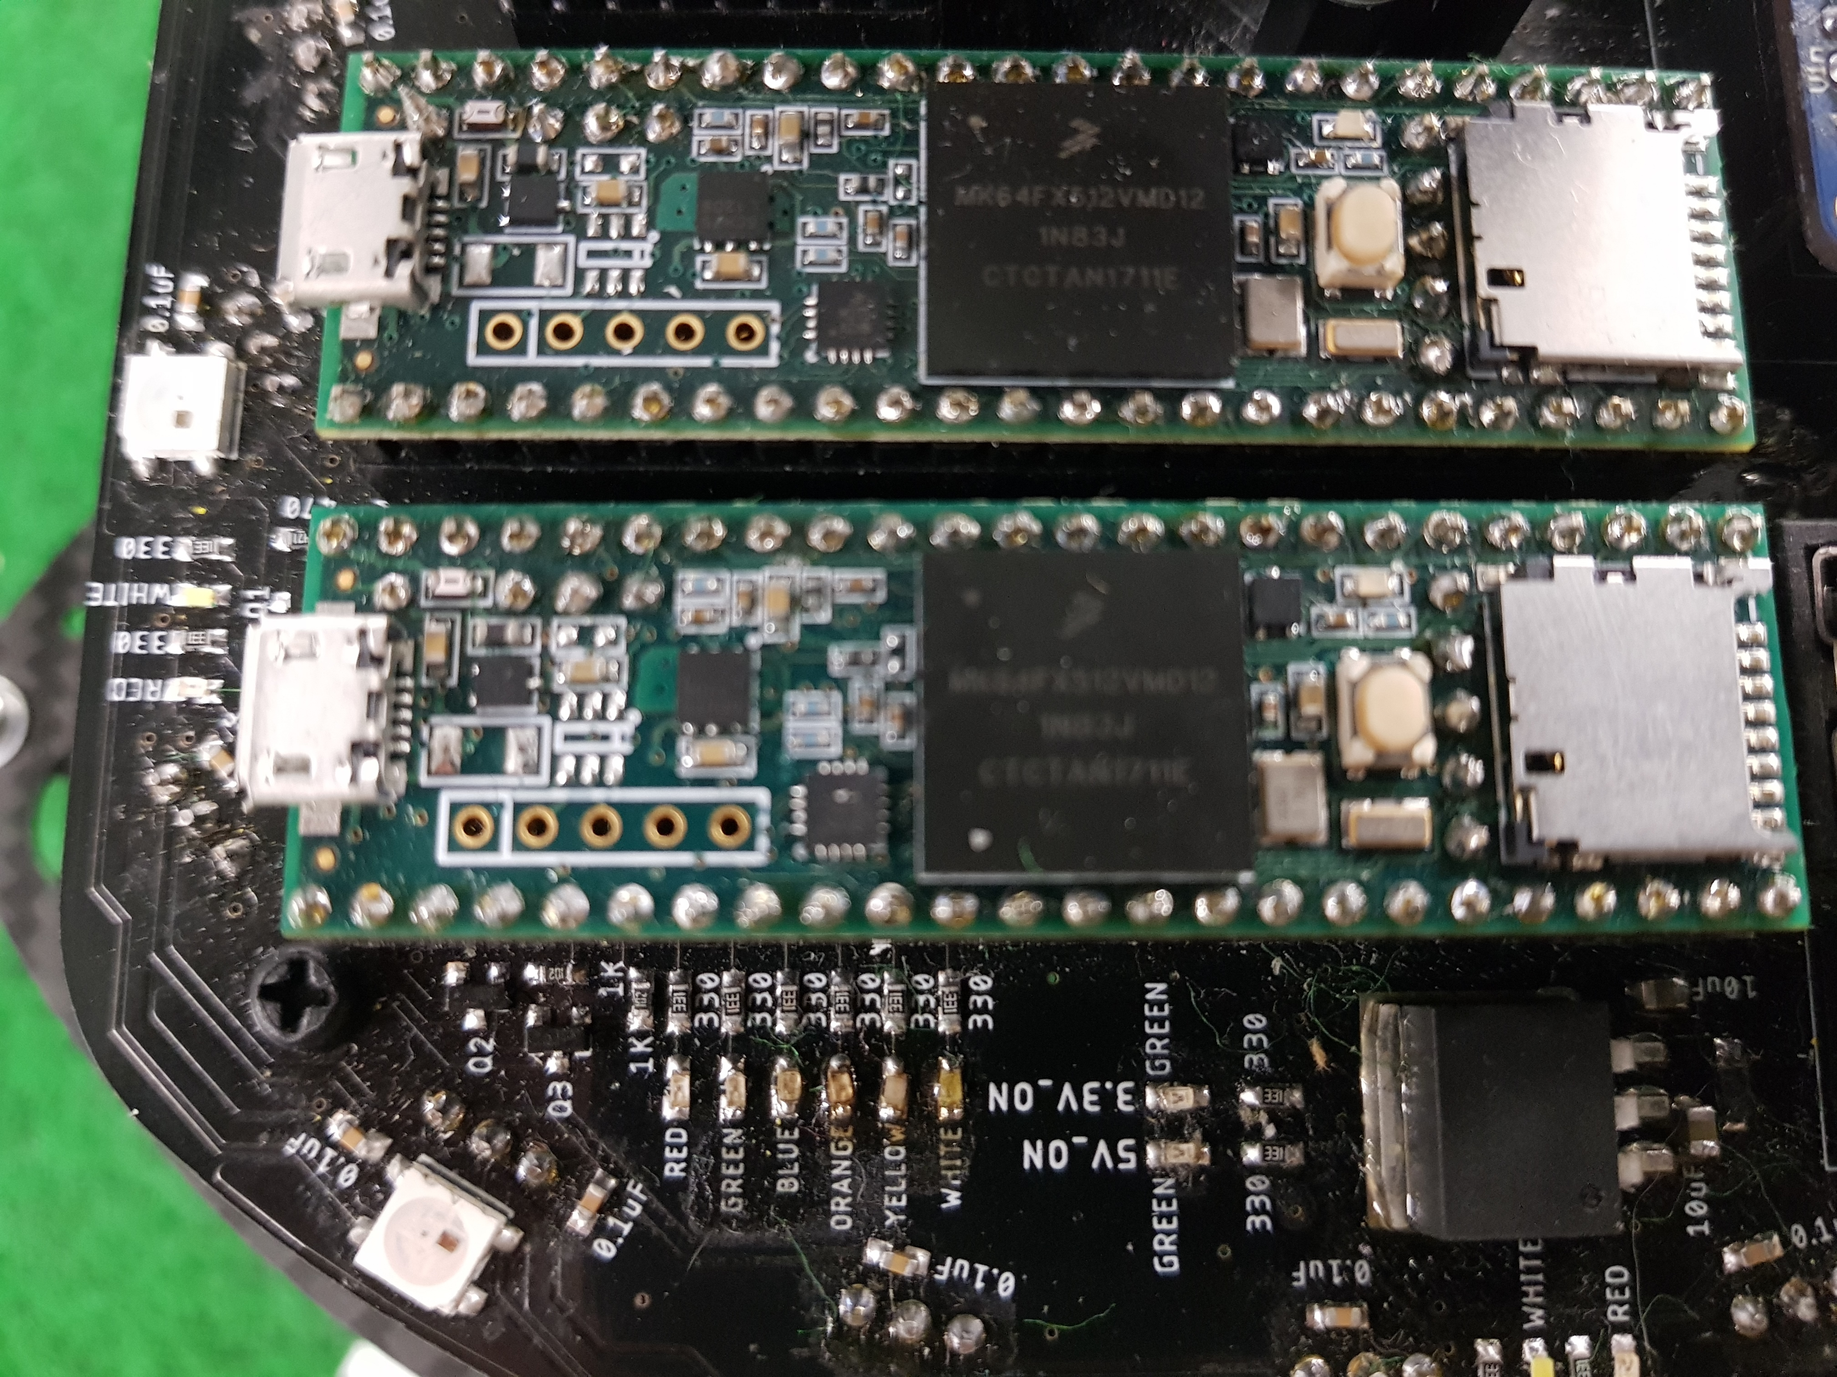
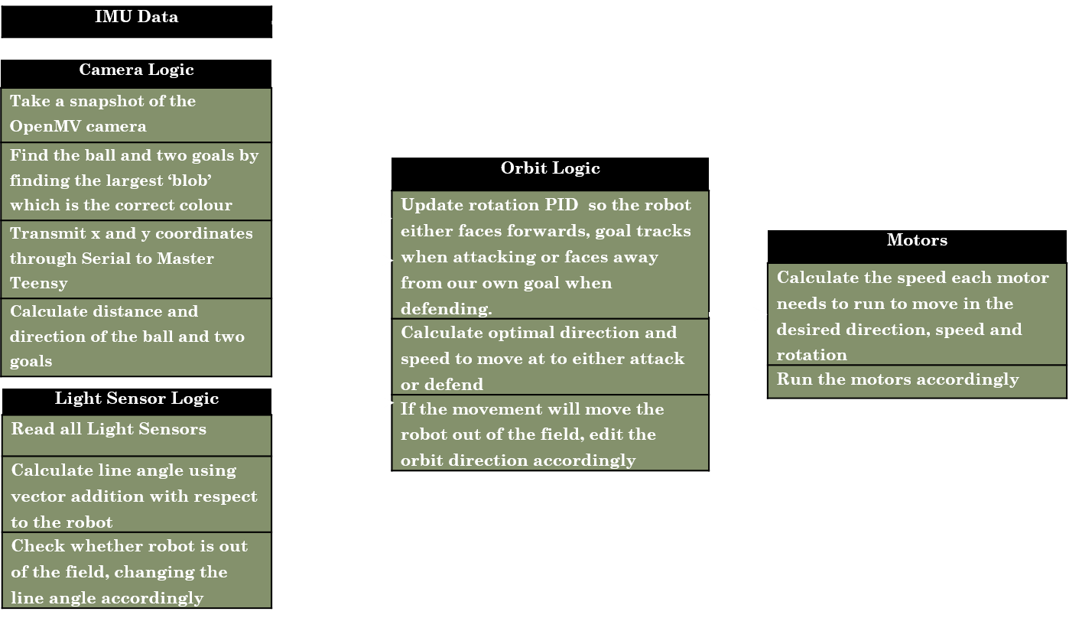
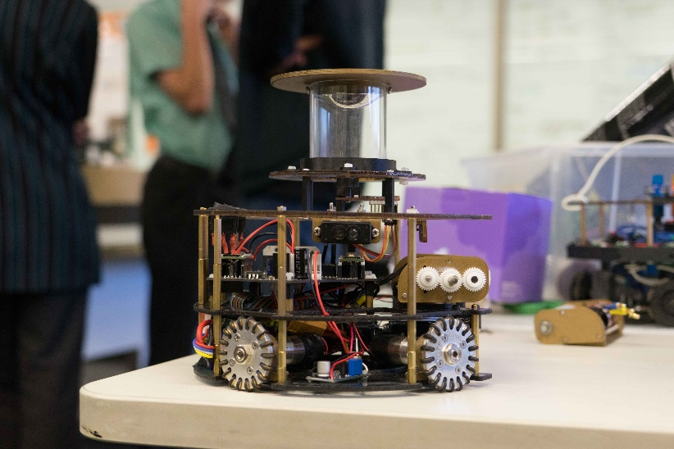
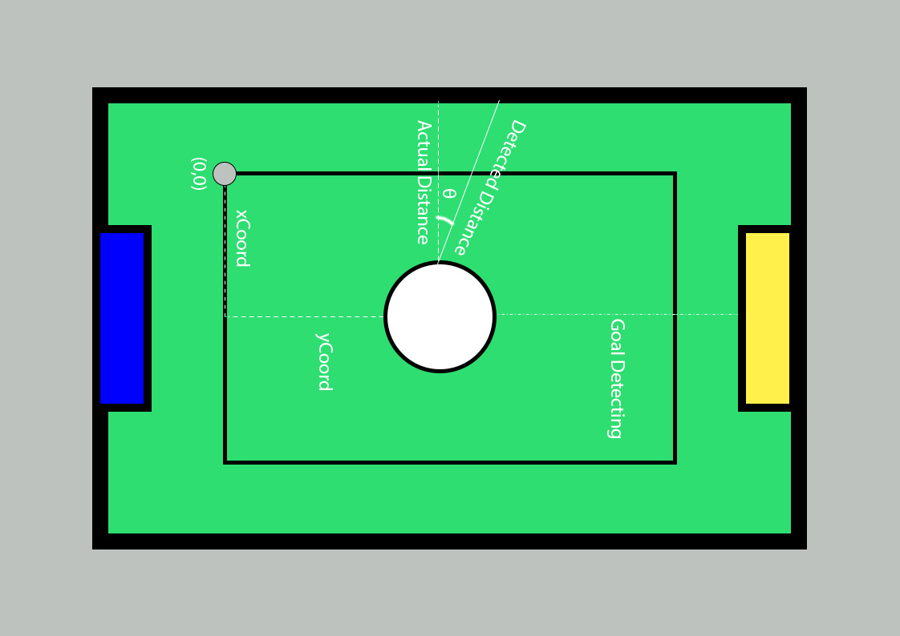
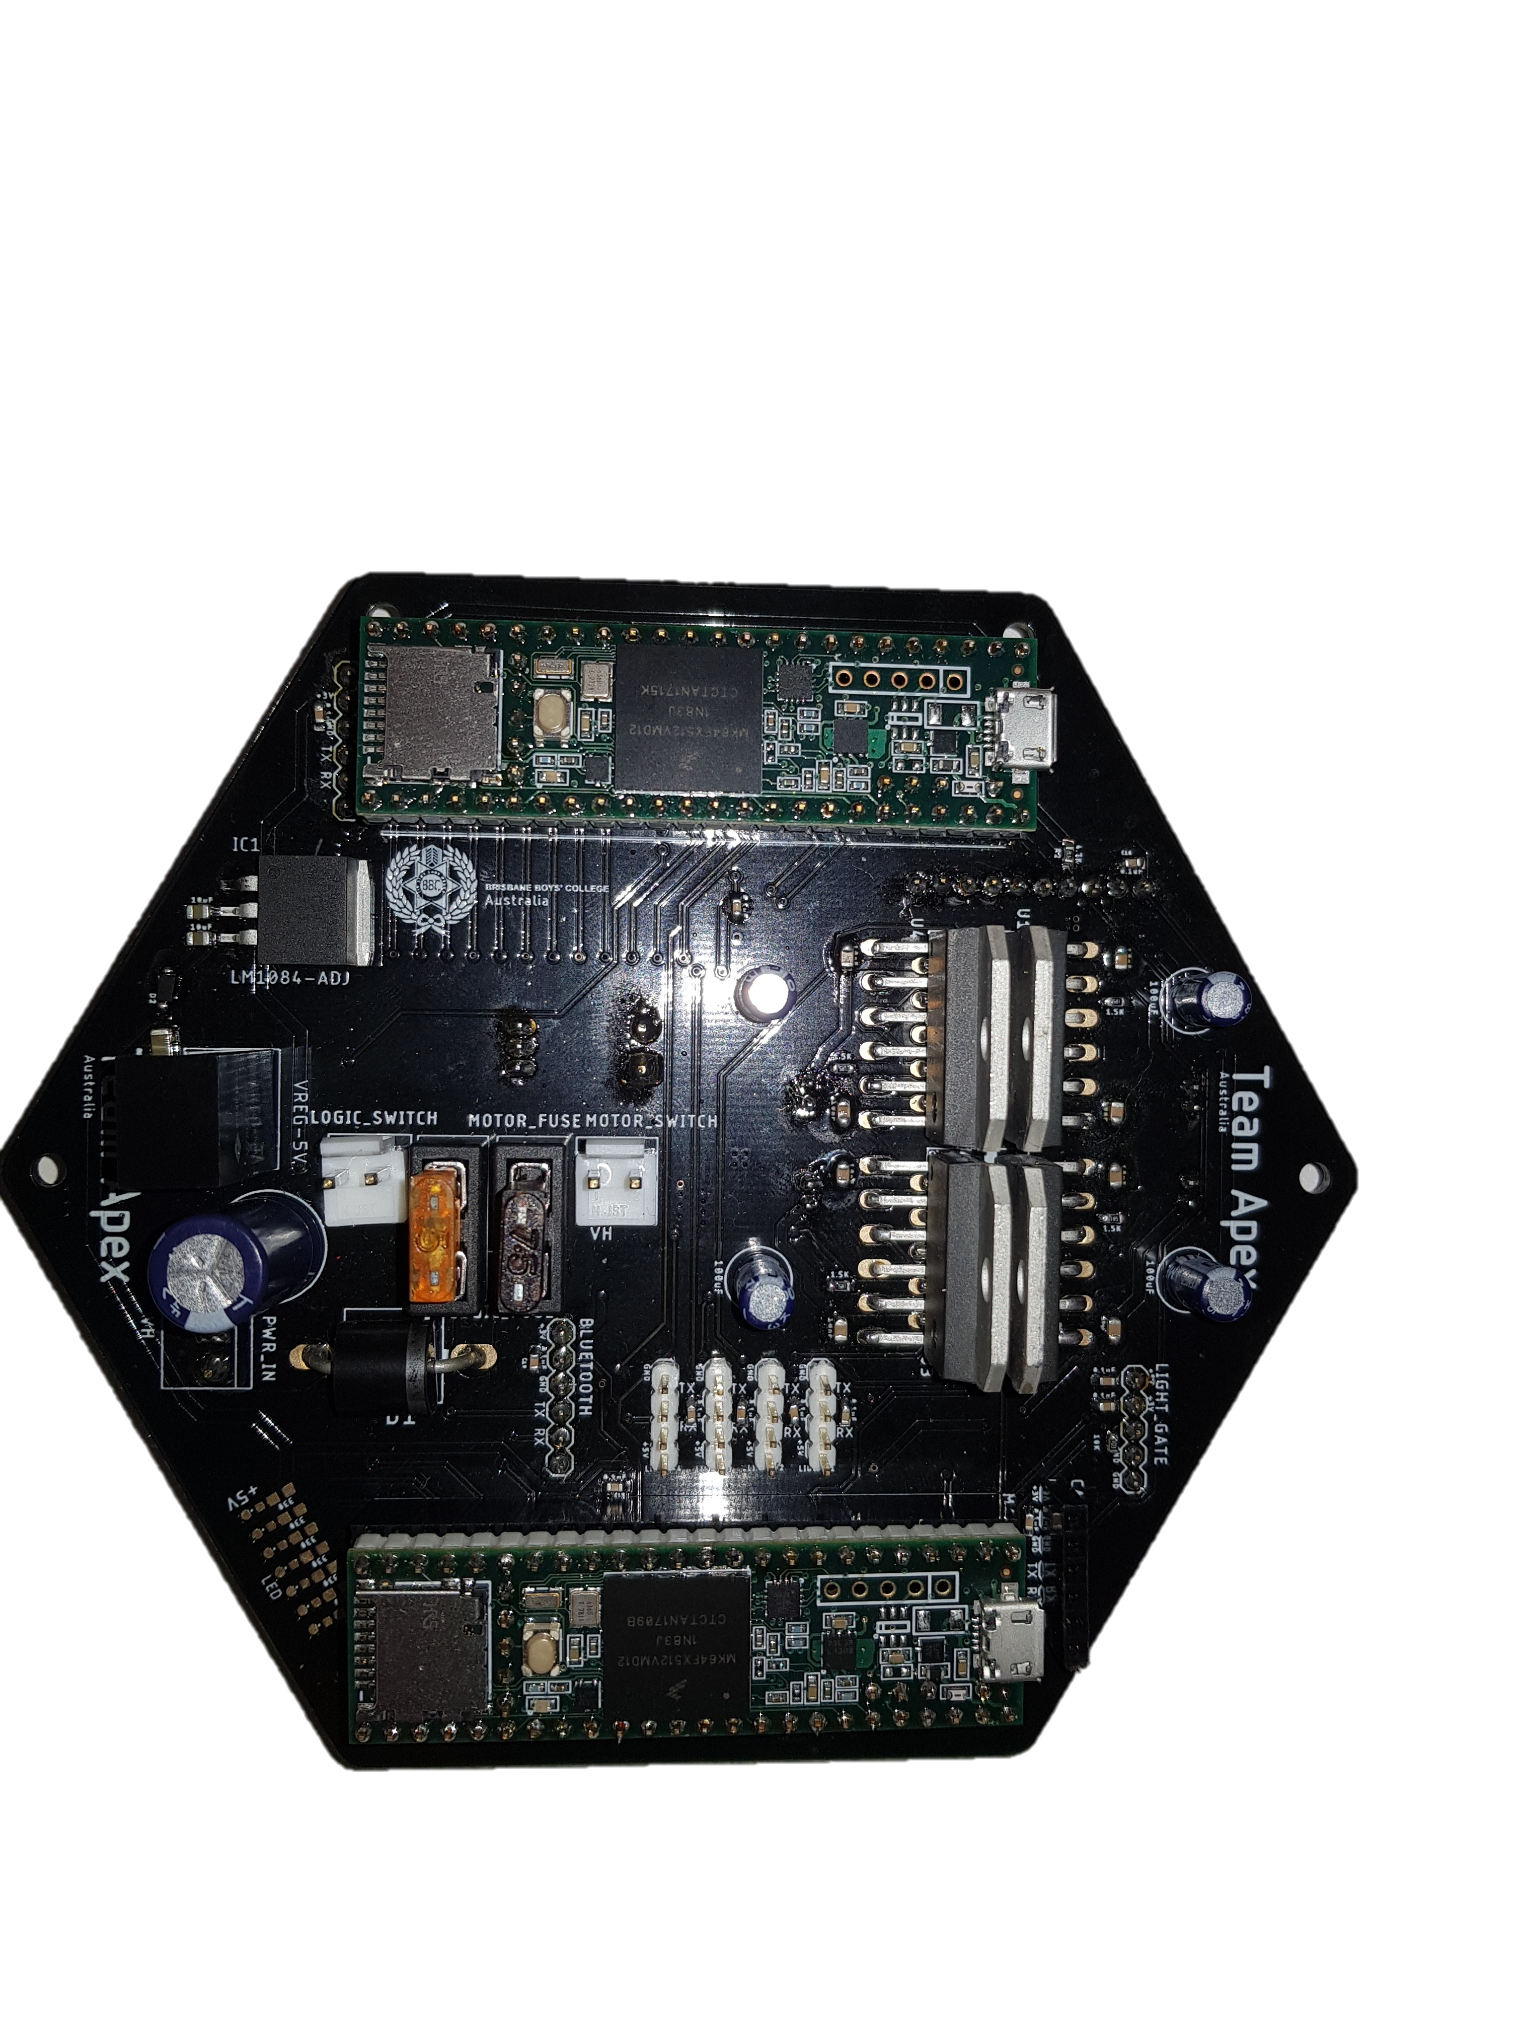
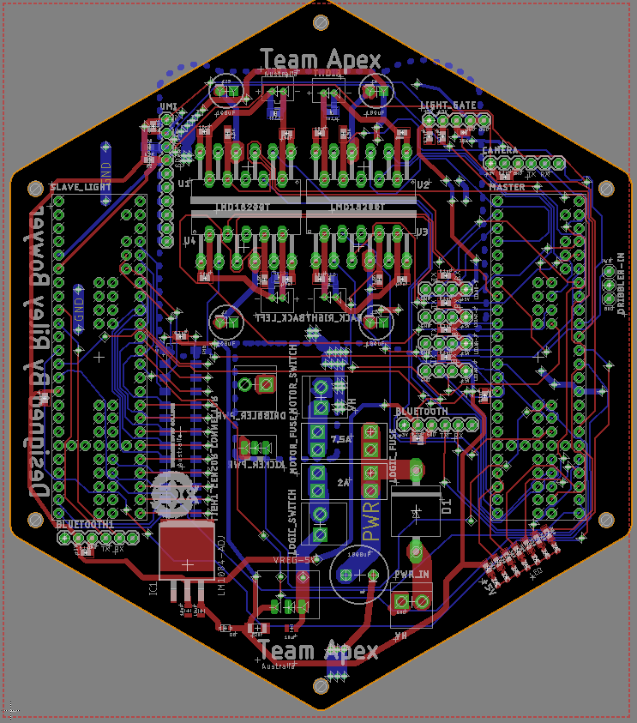

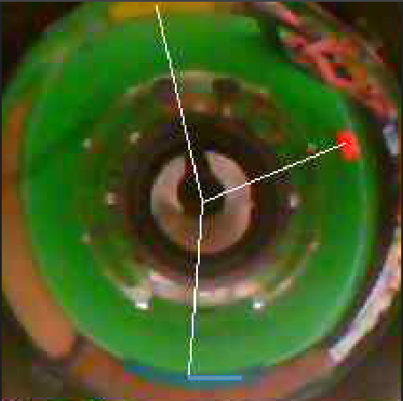
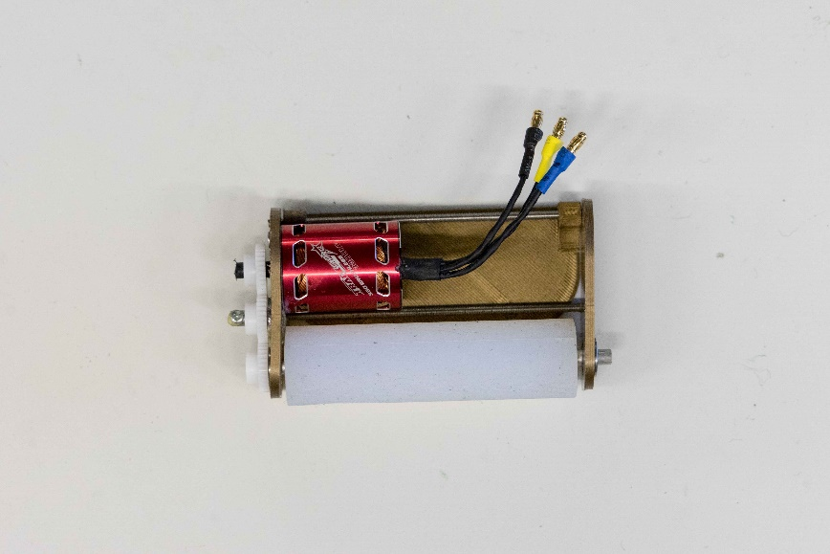

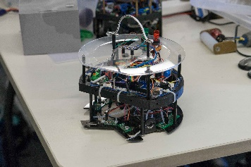
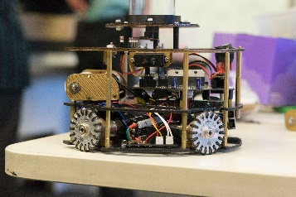
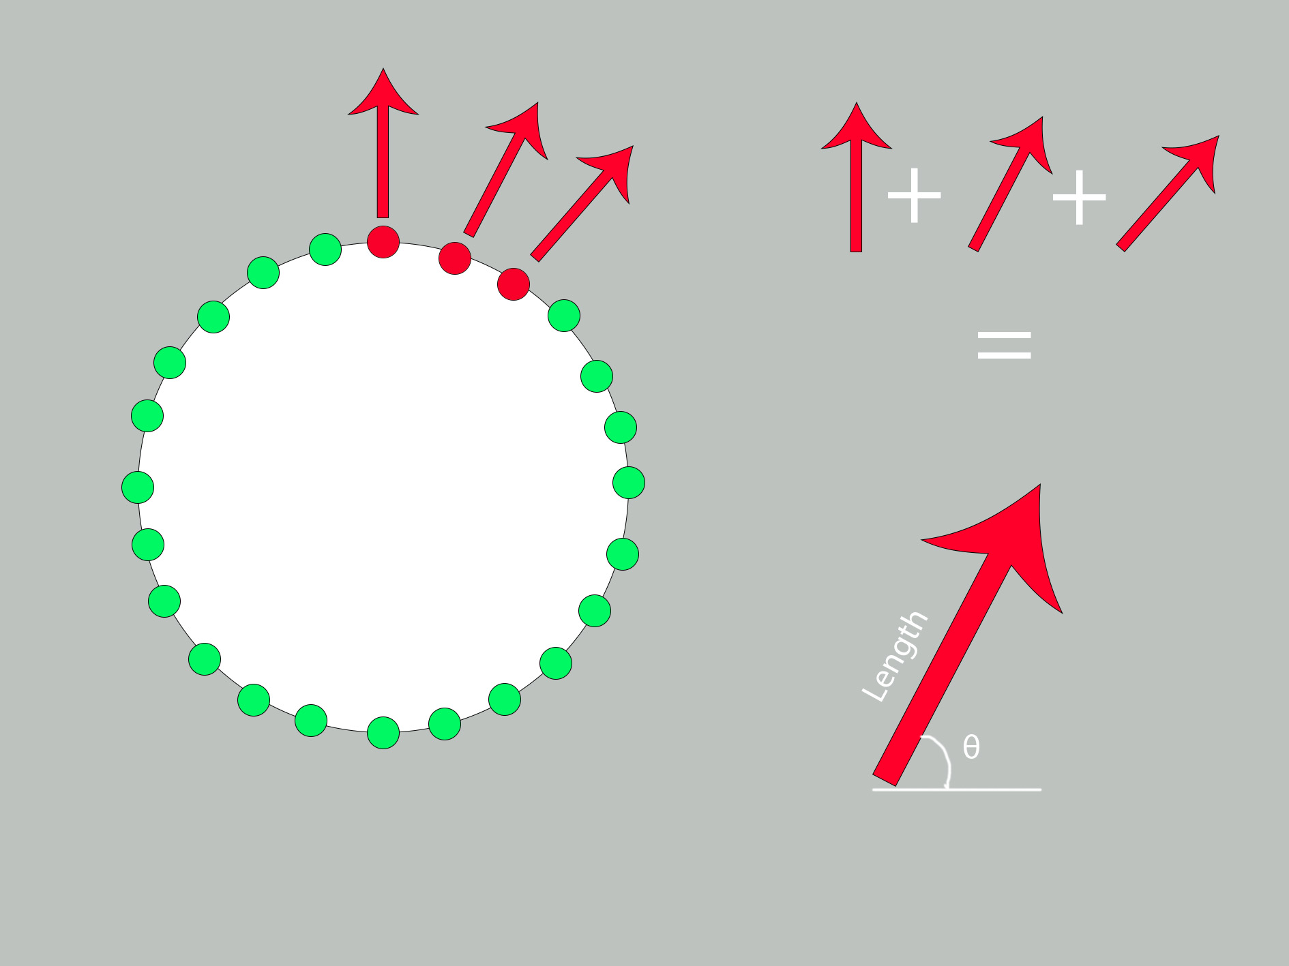
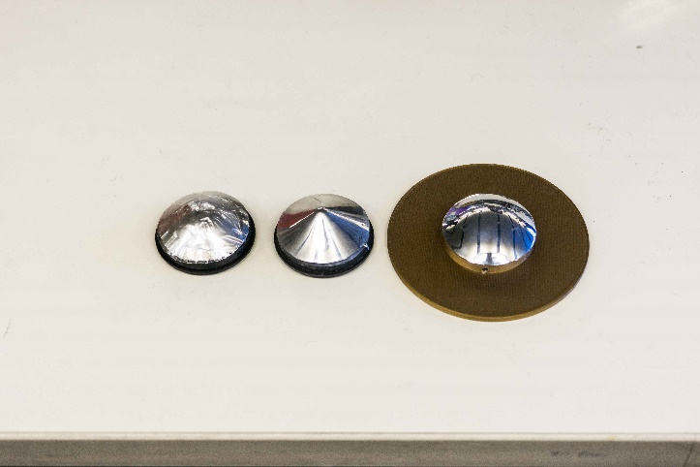
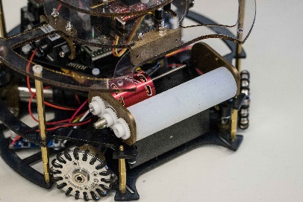
HARDWARE and PRODUCTION
ABSTRACT
SOFTWARE
Team APEX have created two almost identical robots, each comprising of three levels with different components on each plate. Custom made PCBs were utilised to decrease clutter and improve consistency. The major componentry used was:
- 4 x Maxon DCX19 motors
- 4 x LMD18200T motor controllers
- 4 x Omnidirectional wheels
- 4 x Lidar Modules, for use in a field positioning
- 2 x Teensy 3.5 Microcontrollers in a designated slave-master configuration
- 24 Red Light Sensors in a dual ring set-up
- Open MV-M7 camera with object recognition use in conjunction with a 360 degree mirror
- MPU 9250 IMU, dual gyroscope accelerometer
- Light Gate, to detect when ball is captured
- Silicone Dribbler Bar, powered by a trackstar brushless motor
- 2 x HC-05 master-Slave Bluetooth modules for dynamic and advanced strategy
- Linear Solenoid Kicker Circuit
Team APEX is a team from Queensland, Australia, representing the school Brisbane Boys’ College. We consist of 4 Year 12 students.
Team Apex’s robots were designed with utility and accuracy in mind. Constructed using a mixture of laser-cut polycarbonate, high durability 3D printed PLA plastics and printed circuit boards, Apex’s robots were built to last. The tiered structure of our robots allows for quick and easy repair and troubleshooting. The addition of kicker and dribbler systems were incorporated in this years’ design for additional manoeuvrability and control. High quality componentry was utilised, with a primary focus on accuracy: 4 highly accurate and fast Maxon DCX19s with accompanying motor controllers, a dual ringed LED-light sensor design with 24 individual sensors, quad LIDAR units for accurate field positioning and a custom moulded mirror for 360 degree vision in conjunction with an Open MV-M7 camera.
The program was split across three controllers to maximise speed of calculation. Object recognition is used to track various markers, the major focusses being the goals and ball. Calculations are handled by a separate microcontroller pass vectors to the motor controllers. In the event of the camera losing sight of the ball, a signal is triggered to centre the robot on the field using four LIDAR modules and a gyro to maintain goal tracking. Inter-robot communication using HC-05 Bluetooth modules allows for dynamic strategy with defender-attacker logic.
These robots were designed, built and programmed in an incredibly short period of time, being 3 months from competition. The development of a kicker, dribbler, camera, lidar, Bluetooth, and light gate were handled in this short period of time, alongside complete redesign of structure and electronics. Input and advice from other Australian teams made this feat possible in such a short period of time.
Compartmentalising key calculations across three microcontrollers effectively increases processing speed. SPI is used for Master-Slave communication between controllers, ensuring reliable and fast transmission of data. This reduces time of calculations. This also effectively splits the development of software, making future debugging and optimisation far easier.
Design
A variety of CAD software's were used in the design process. Inventor and Fusion 360 were utilised for fast rendering of ideas, and the development of the final design. Fusion 360’s basis around team coordination was useful for group collaboration and ensuring everyone had access to all files. Eagle was used in the design of all electronics, the PCBs designed being compact and utilitarian. These served to increase reliability and room for complexity in design. The new Fusion-Eagle link was especially useful for quick implementation of PCBs into general design. Many iterations of both general design and PCBs were made, each experimenting with different shapes and positioning.
Camera
The ball and goals are detected via the Open-MV camera. For every snapshot of the camera, the image is scanned for the colours of the ball and goals. Their x and y coordinates are sent through serial communication to the master teensy. The direction of each entity is easily calculated from their coordinates. Exponential functions were modelled so that the distance of each entity can also be calculated with reasonable accuracy. Exponential functions were required because the relation between pixels and distance was exponential due to the mirror shape.
Field Coordinate
New Technologies
The development of new features, namely the field positioning and 360 camera, were identified as necessary components in order to be competitive. This was gathered from the experience of multiple generations of Robocup participants and from observing previous international competitions. As such, the development of these components was prioritised.
Lidar logic was written with constant goal tracking in mind. The data from the onboard IMU is used in calculations to correct for the robot’s heading. This data is interpreted using simple trigonometry to develop an accurate on-field position. In conjunction with the camera, key locations are attributed with a corresponding location and transmitted to the other robot via Bluetooth. This allows for constant and accurate tracking even without line of sight. This development was found to be especially useful for superteam due to limited camera range. Location data is used to move the robot into high traffic zones such as in front of the goals.
Main PCB
LIDAR
Field positioning was made possible through the use of LIDAR Modules. Accurate to a 10th of a millimetre, four sensors were positioned at 90 degree intervals on the robot. This system allows for accurate positioning of both robots simultaneously. This data is used in various applications, being transmission of field coordinates via Bluetooth and a defender protocol. This system is also highly effective in super team, as it allows search patterns to be executed when the ball is outside of visual range.
Dribbler
The assembly of the dribbler is mainly 3D printed and designed for maximum control of the ball. The brushless motor spins a custom moulded silicon bar. After the robot has line of sight of the goal, the solenoid is activated kicking the ball. The ability to control the ball, especially with a passive ball relying on visual tracking allows for the robot to move with speed and still have control over the ball. The position of the dribbler on the robot also allows for the silicon bar to grab the top of the ball as it pivots on the 3D print. Elastic material applies constant downwards pressure on the ball, ensuring a constant connection between dribbler and ball.
BLUETOOTH
Two Bluetooth modules on each robot allow for inter-robot communication. They are set up in a master-slave configuration. This allows for the inclusion of advanced strategy. These modules were used to convey key information such as ball and opposition position. This data was gathered from use of our field positioning system. Advanced strategy such as a defender swapping to an attacker depending on proximity of the ball was enabled through the use of this communication protocol.
TESTING and DEVELOPMENT
Light Sensors
360 Camera
The assembly comprises of an OpenMV M7 Camera, 3D printed mount and a transparent acrylic tube, attached to another 3D printed mirror mount. The 360 degree function is made possible by the camera looking at a parabolic shaped piece of mirror. The moulded piece of mirror was created by heating it up and forming it over a specifically designed mould. The wide plate on the very top is there to stop interference from exterior light sources.
The Robot detects the line via 24 light sensors. Each light sensor has been assigned a unique vector. Upon detecting the line, the vectors of all sensors that have been triggered are summed. This produces a final vector that leads the robot back into the field of play in minimal time.
Progression to Passive Ball
Focus for software was largely directed towards the transition to passive ball. One of the largest challenges was to get an accurate distance calculation for the ball and two goals (whereas in the previous year no camera was used and the strength of IR light was used for the ball). By using calculations relying on the reflection of light, a theoretical model was achieved. Unfortunately, this didn’t work practically. Due to the inaccuracy in the shaping of the mirror and other variables such as refraction, the model did not work. Instead the distance of the goals in terms of pixels was recorded against actual distance and an exponential function modelled the data. This modelled the distance of the ball and goals well, dramatically increasing accuracy.
Team APEX – 2017 Robot
Various Iterations of mirror design
Team APEX – 2018 Robot
Development of Dribbler
Various iterations of dribbler design and material were experimented with. A material with high durability and grip was found to be necessary to be used as a base. 3D printed shapes were coated in a variety of rubber materials and compared. These were all found to be sub-par and additional materials were investigated. Two part silicone sealant was found to be an effective material, with a high durability and grip. Following the decision of material, different design types were tried. Originally a heavy conical design was tested, but produced rotation at suboptimal angles pulling the ball from the capture zone. A spiralled design was found to only just increase the ability to centre the ball, but decreased control and consistency. Hence a plain bar shape was decided upon for simplicity and consistency.
Creation of Camera
In the development of the camera various materials and designs were tested The camera is the key component of open soccer, hence a camera and mirror that perform consistently and effectively were necessary. Chrome balls were experimented with in conjunction with a PIXY cam, but this produced poor results. A cloudy and minimal view of the field was the best that could be produced. As such, we looked into custom moulding of plastic in attempt to make mirrors with optimal angles and design. Various materials were used, but plastic coated materials melted, obscuring the mirrored surface before being properly moulded. An alternative plastic which was not hindered by this factor was sourced and results improved drastically. Mirror shapes were experimented with via CAD software, simulations being used to determine an optimum shape. A rounded mirror surface was found to be the most effective, and 3D printed for use as a mould.
Final dribbler design

